Slide 1
Nearest Province Finder
Haoyang Wang
Zhou Fang

Slide 2
72.5M
Problem: How to find the nearest province in a large dataset

Slide 3
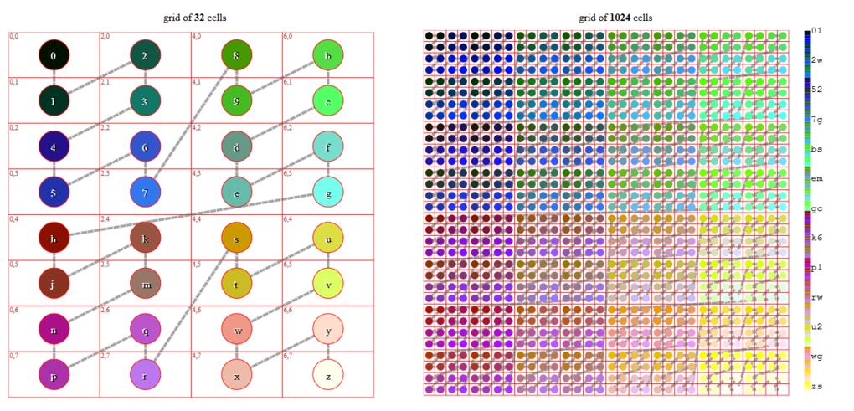
Project Proposal: GeoHash
Geohash is a public domain geocode system which encodes a geographic location into a short string of letters and digits.

Slide 4
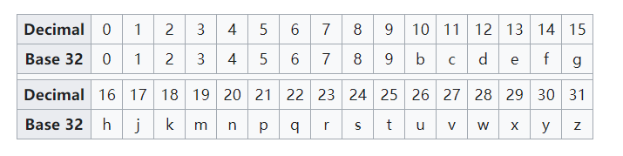

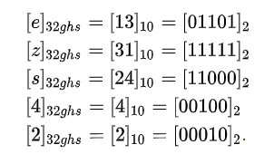
Project Proposal: GeoHash
01101 11111 11000 00100 00010
Longitude: 0111110000000
Latitude: 101111001001

Slide 5
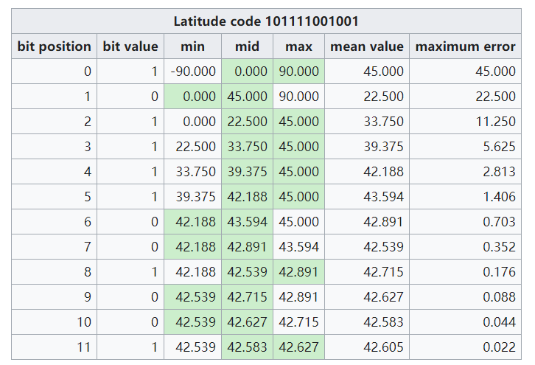
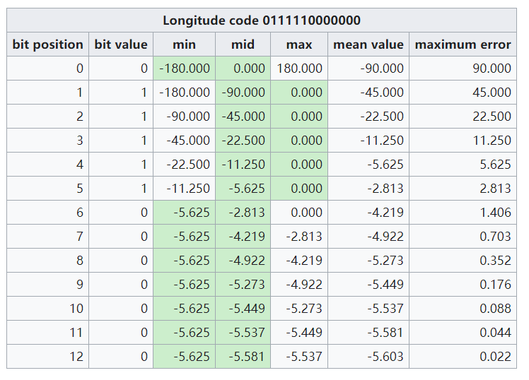
Project Proposal: GeoHash
Input Coordinate
Hash
GeoHash(intput)
Find
GeoHash(output)
Hash
Output Coordinate

Slide 6
Project Design Requirements
Programming Language：Python
Implement GeoHash algorithm
GUI
Map of USA
Get the location of user clicked
Display the nearest province

